Slide 1
Who is next? Analysis of cyber attacks reported between 2017-2018

Slide 2
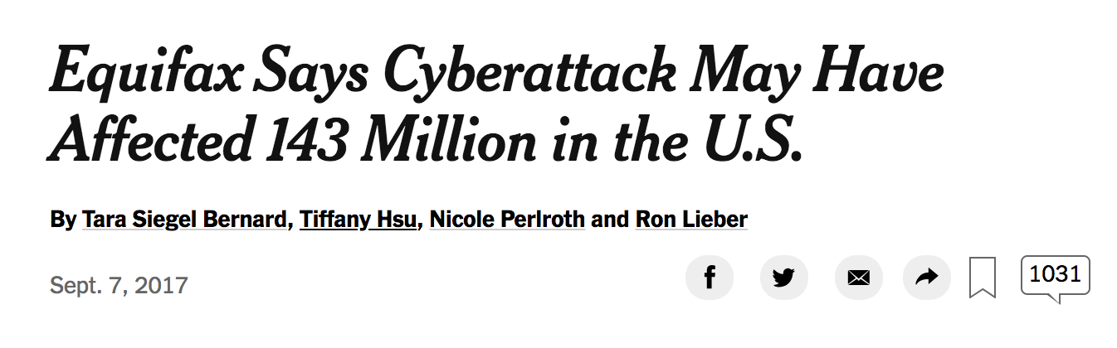
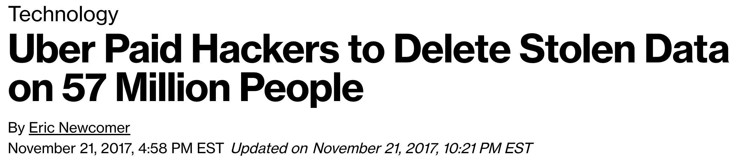

Slide 3
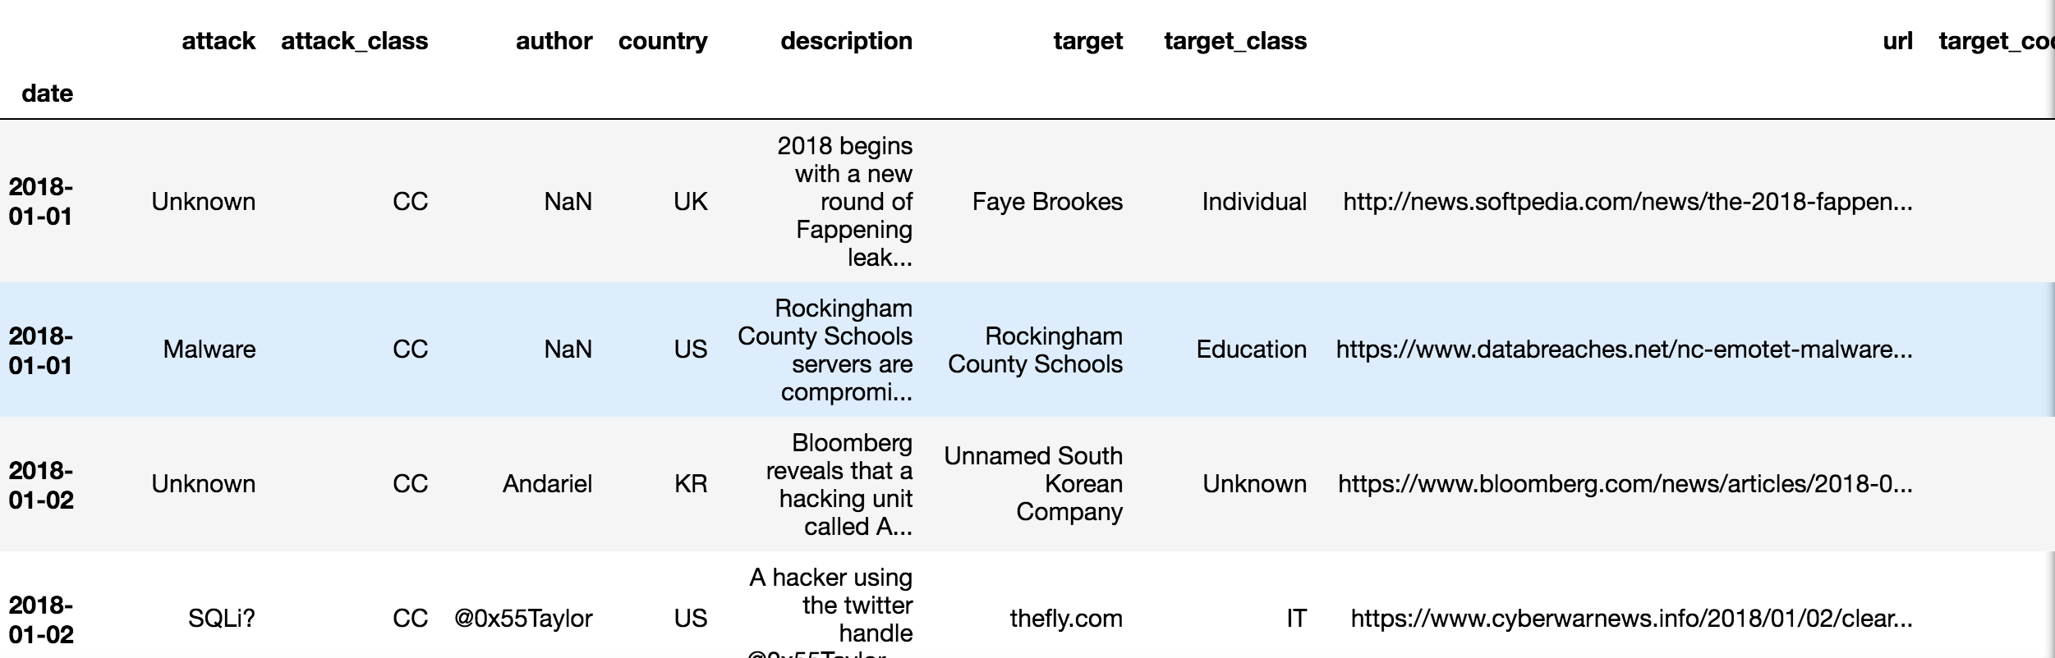
Hackmageddon
scraped www.hackmageddon.com to collect information on:
Date of attack
Target
Target_class (industry category)
Country
Summary
Type of attack( crime, espionage, hacktivism, warfare)

Slide 4
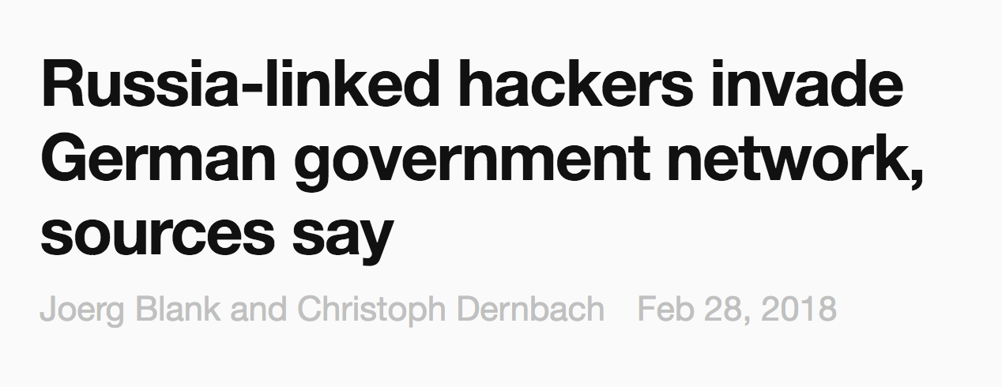
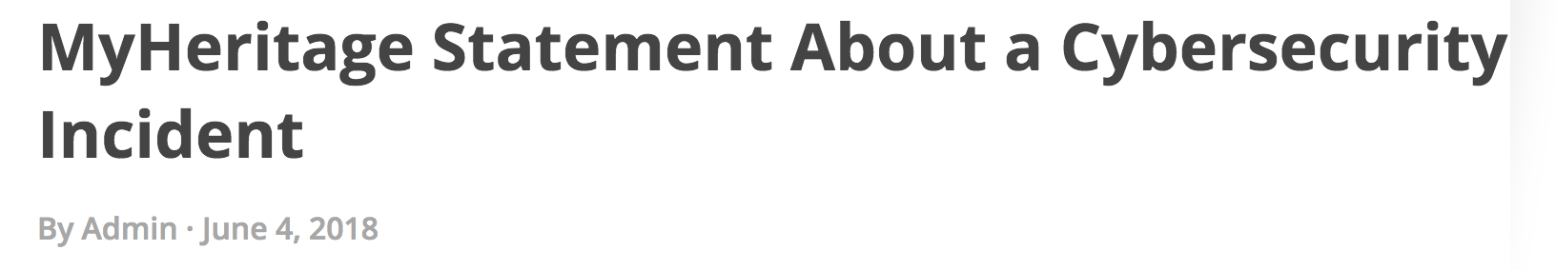
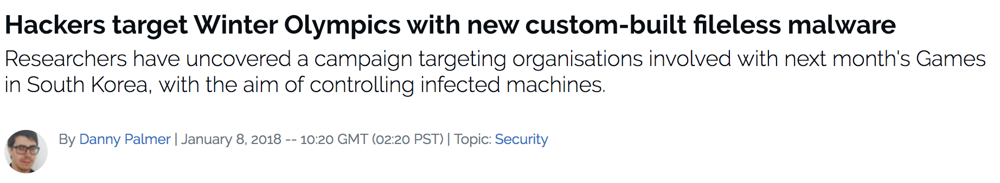

Slide 5
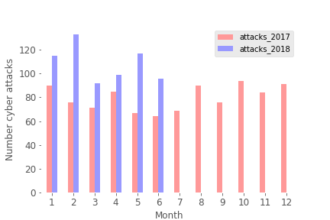
Trend of increasing cyber attacks for 2018

Slide 6
Top 5 categories affected: Individuals Healthcare Fintech Finances Multiple

Slide 7
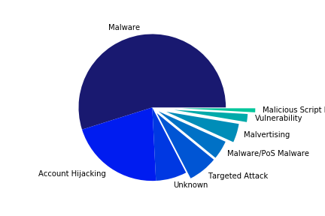
Main attack on individuals: MALWARE

Slide 8
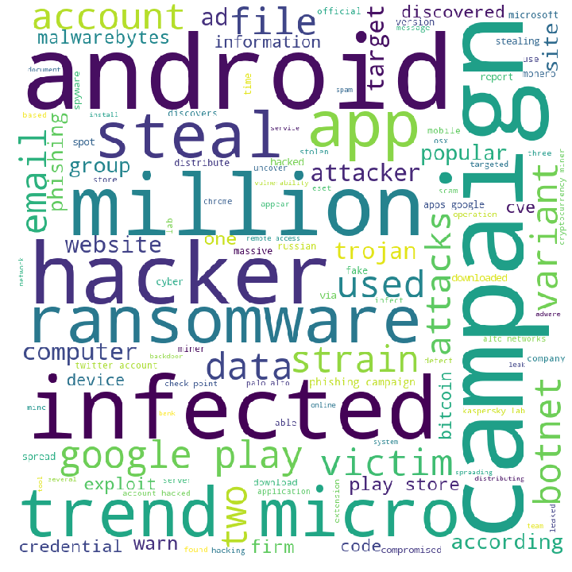
Individuals: WordCloud

Slide 9
Top 5 industries affected: Individuals Healthcare Fintech Finances Multiple

Slide 10
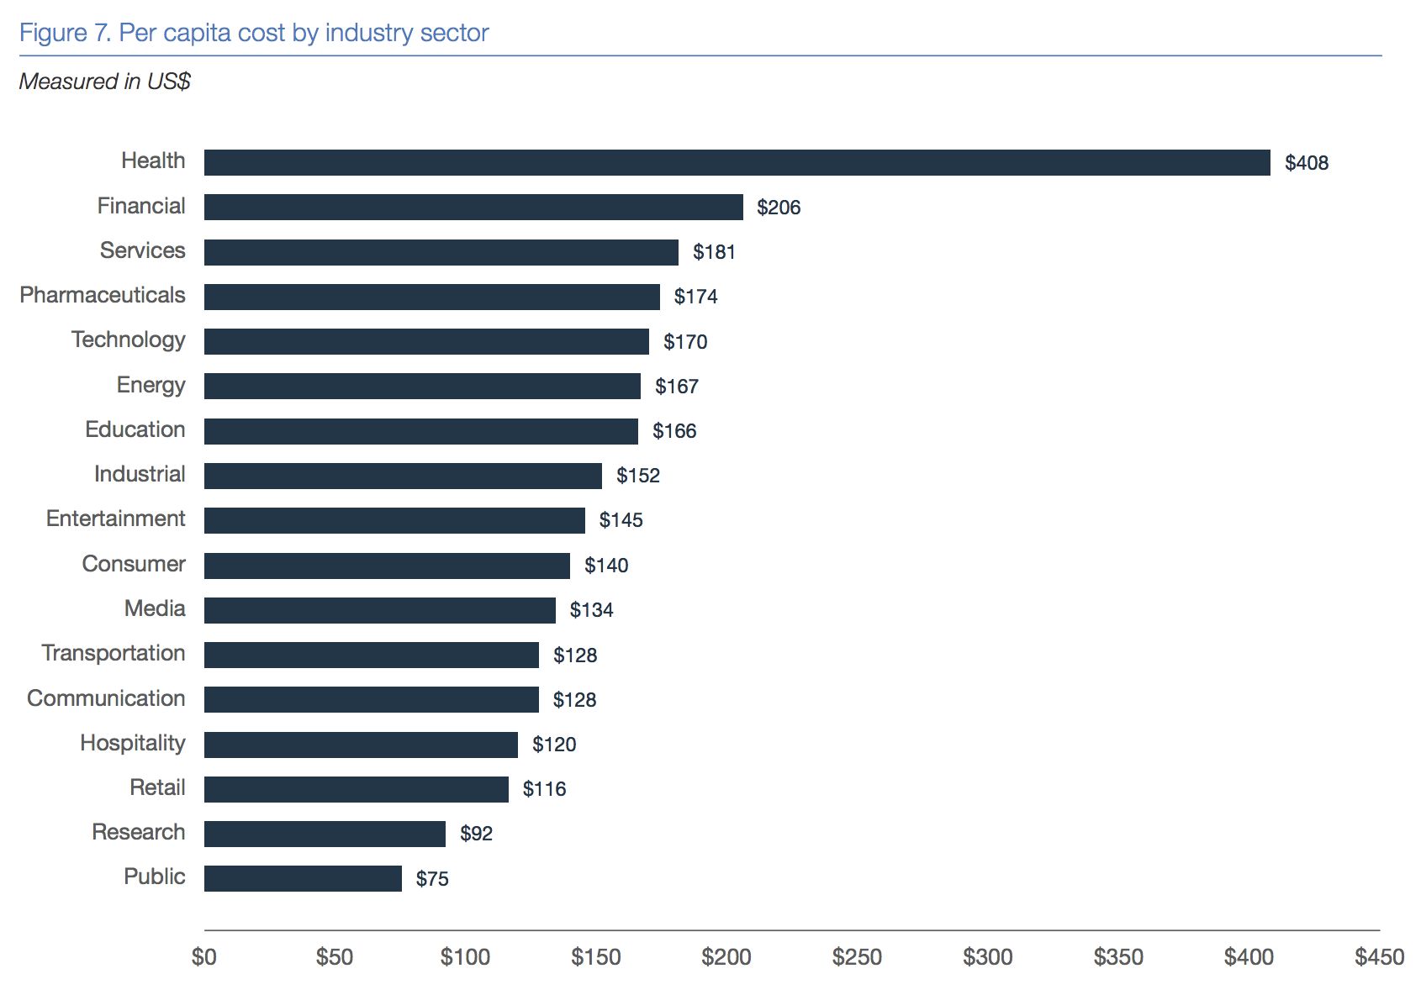
Data breach costs are highest for healthcare industry
The 2018 Cost of a Data Breach Study by the Ponemon Institute

Slide 11
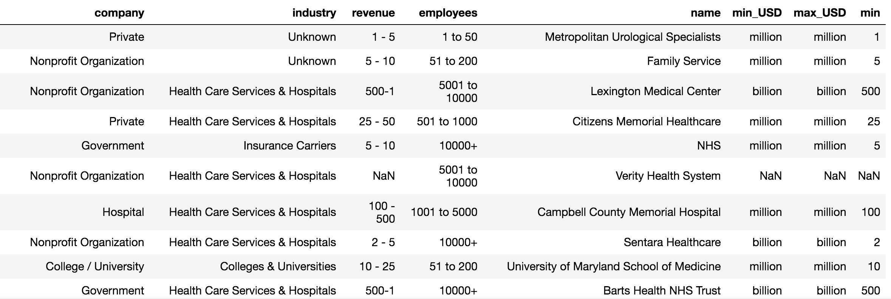
Glassdoor
identified companies/organizations with healthcare sector from hackmageddon dataset
scraped www.glassdoor.com to collect information on:
Company name
Category
Revenue
Employees

Slide 12
Revenue and number of employees are dependent
Chi –sq test : p<0.001

Slide 13
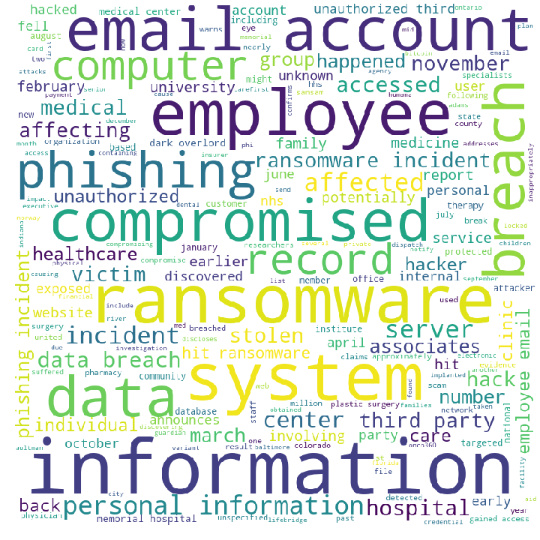
Healthcare: WordCloud

Slide 14
Healthcare: Attacks by employees

Slide 15
Healthcare: Attacks by category employees
Hospitals
Private
companies
Nonprofits

Slide 16
Healthcare: Attacks category by employees
Hospitals
Private
companies
Nonprofits

Slide 17
Healthcare: Attacks category by employees
Hospitals
Private
companies
Nonprofits

Slide 18
Relationship between employees and revenue

Slide 19
Conclusions
Individuals
Every individual using the internet is a potential target
App downloads, email accounts
Tip: avoid free wi-fi and useless apps
Healthcare
Hospitals, small private companies, and large non-profits are main targets
Phishing emails to employees
Tip: scale up cyber security training for employees
Ransomware is becoming more popular
Tip: scale up cyber security investment!
Unsupervised Machine Learning for clustering to identify predictors

